Slide 1
Early Warning System for Academic Performance
Team – 2
B. Sravan Kumar (20EG110103)
P. Abhilash Reddy (20EG110119)
P. Akhil Kumar (20EG110121)
Project Supervisor
Ms. B. Jyothi
Assistant Professor
Department of Data Science

Slide 2
Introduction:
The Early Warning System (EWS) for Academic Performance is a data-driven solution designed to address the challenges in monitoring and supporting student success in educational institutions. With the increasing complexity of academic programs and the diverse needs of students, it has become crucial to develop systems that can identify at-risk students early and provide timely interventions.
The following are required to develop the system:
1. Data: The system requires access to data related to student performance, including internal exam scores, attendance records, credits earned, and contact information.
2. Machine Learning Models: To predict student performance, machine learning models are used.
3. Alerting Mechanism: An email-based alerting system is employed to notify both students and academic staff of potential issues.

Slide 3
Applications:
The Early Warning System has several applications, including but not limited to:
Identifying students at risk of failing or falling behind in their coursework.
Providing personalized feedback and recommendations to students for improvement.
Assisting academic advisors and instructors in targeting interventions.
Enhancing overall student retention and success rates.

Slide 4
Problem Statement:
The problem addressed by this system is the challenge of identifying students who may be facing academic difficulties early in the semester. Without timely intervention, these students may struggle and potentially drop out, leading to negative consequences for both the students and the institution.
Illustration of the Problem:
Consider a scenario where many students are enrolled in a challenging academic program. Some students may have low internal exam scores, irregular attendance, or a shortage of credits. Without a systematic approach to identify and assist these students, they may face academic setbacks and even academic probation.

Slide 5
Proposed Method:
The proposed Early Warning System leverages machine learning techniques to predict students' external exam scores based on their internal exam scores. The steps involved include data collection, preprocessing, model training, and evaluation. The system also considers attendance and credit records to provide a comprehensive view of student performance.

Slide 6
Illustration for Proposed Method:
Data Collection: The system collects data on internal exam scores, attendance, and credits from educational institutions.
Preprocessing: Data preprocessing involves cleaning and transforming the data to make it suitable for analysis.
Model Training: Machine learning models like Linear Regression, Ridge Regression, SVR, Polynomial Regression, and Random Forest Regression are trained on historical data.
Prediction: The trained models are used to predict student’s external exam scores.
Alerting: Alerts are generated for students who may be at risk based on their predicted scores, attendance, and credit status.

Slide 7
Experiment Environment
System Requirements:
Processor: Dual core i3 or equivalent.
RAM: 4GB.
Hard Disk: 128GB
Operating System:
Linux, Windows 10, macOS
Internet Connectivity
IDE:
Visual Studio Code
PyCharm
Python IDE
Coding Language: Python 3.10.11

Slide 8
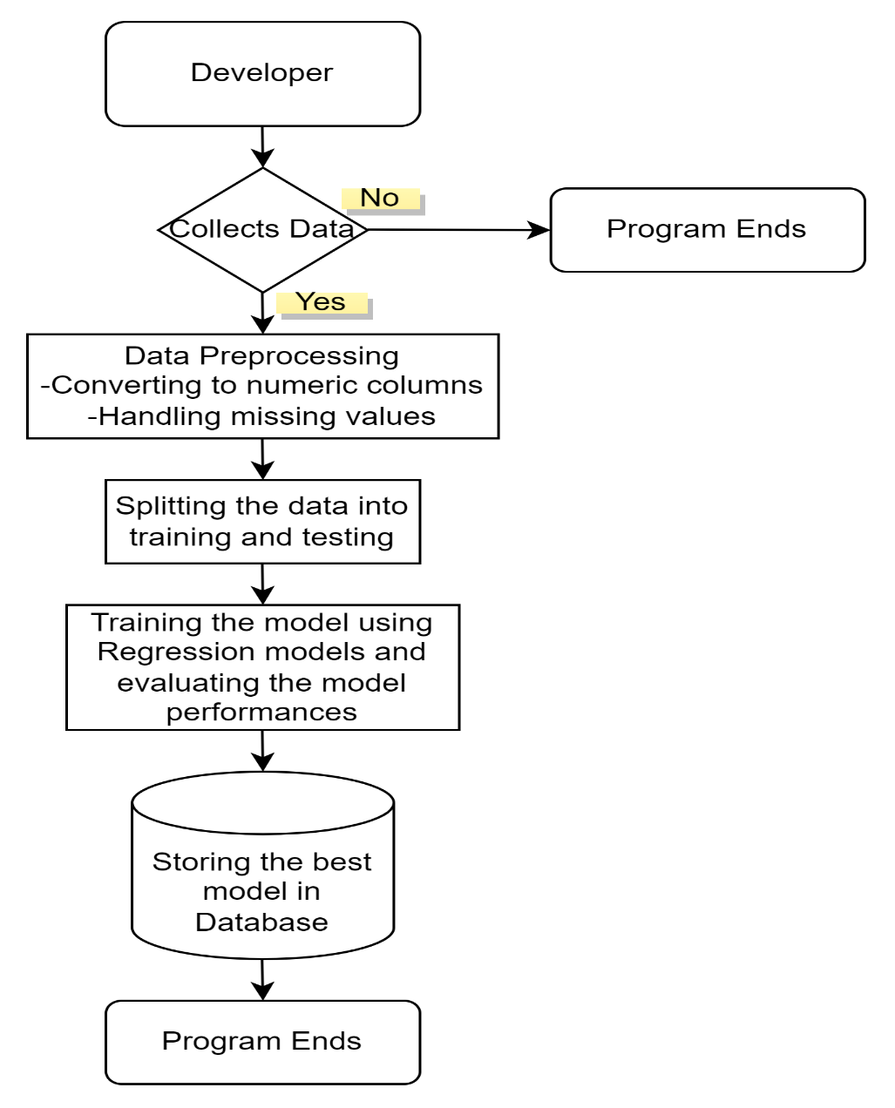
Block Diagram:
Block diagram at the developer end

Slide 9
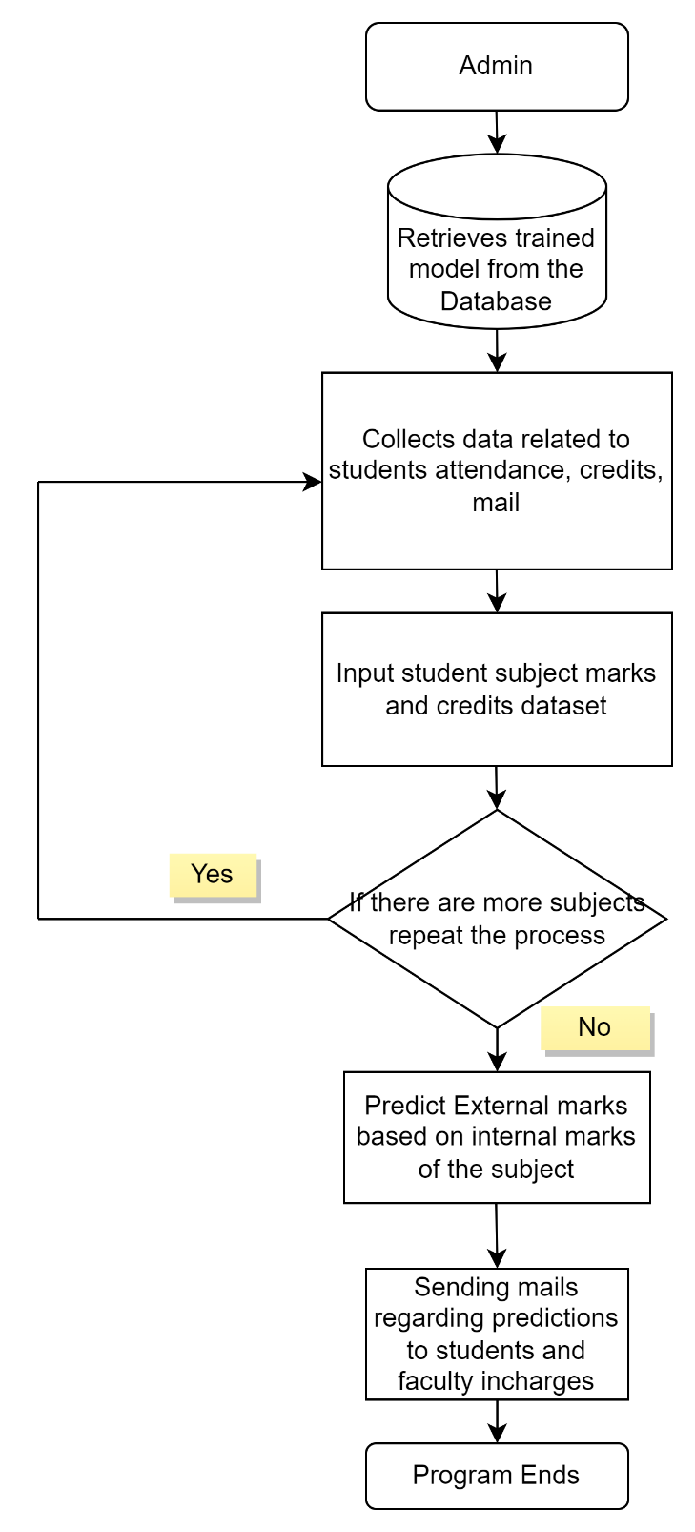
Block diagram at the user end

Slide 10
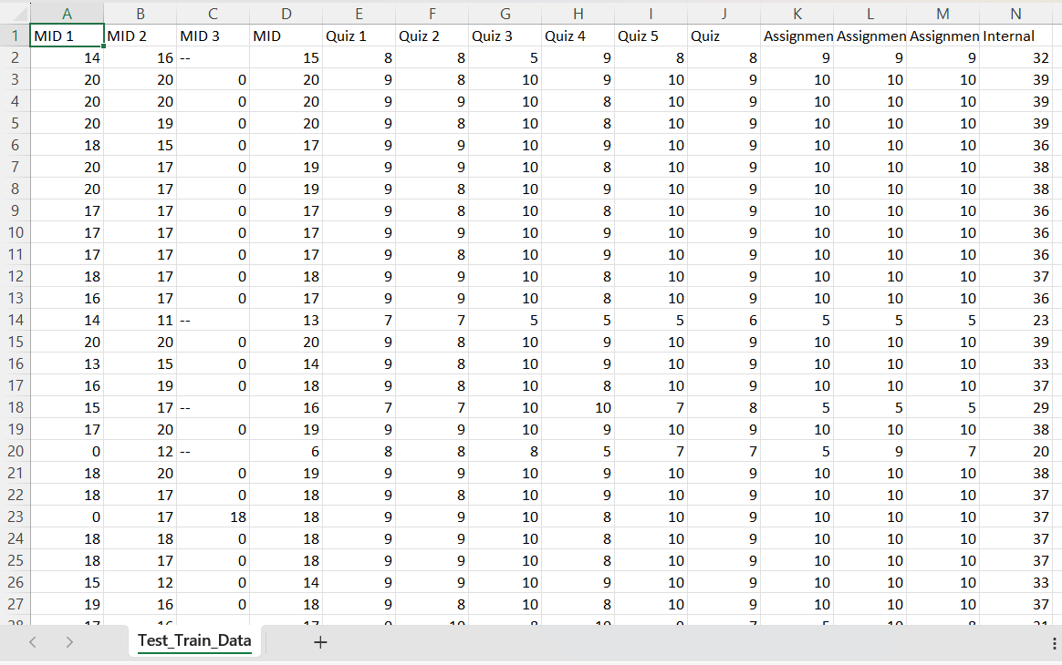
Sample Training data

Slide 11
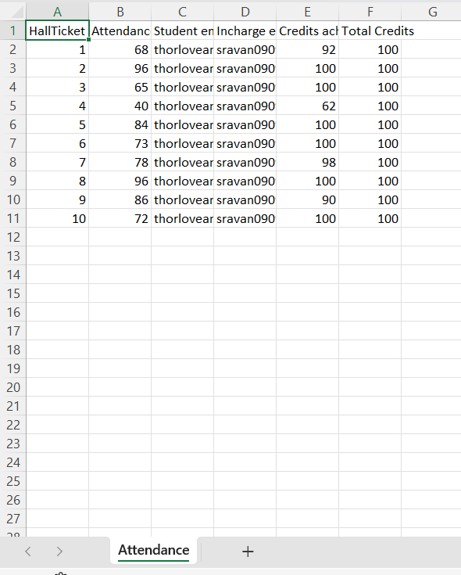
Sample Testing data

Slide 12
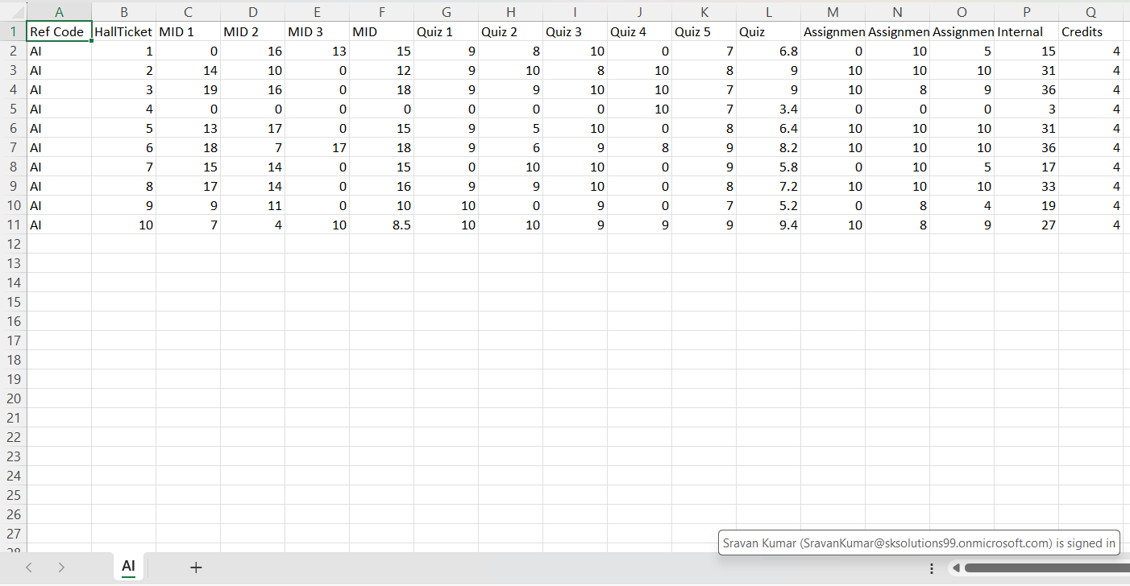
Sample Testing data

Slide 13
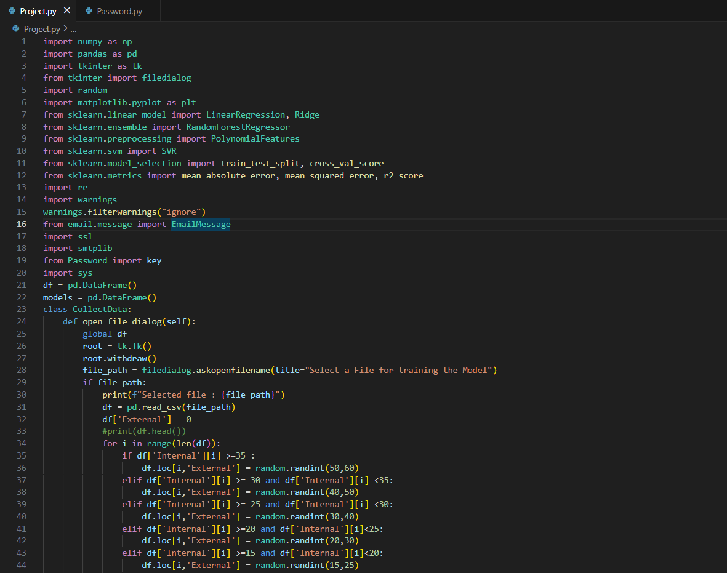
Sample Code

Slide 14
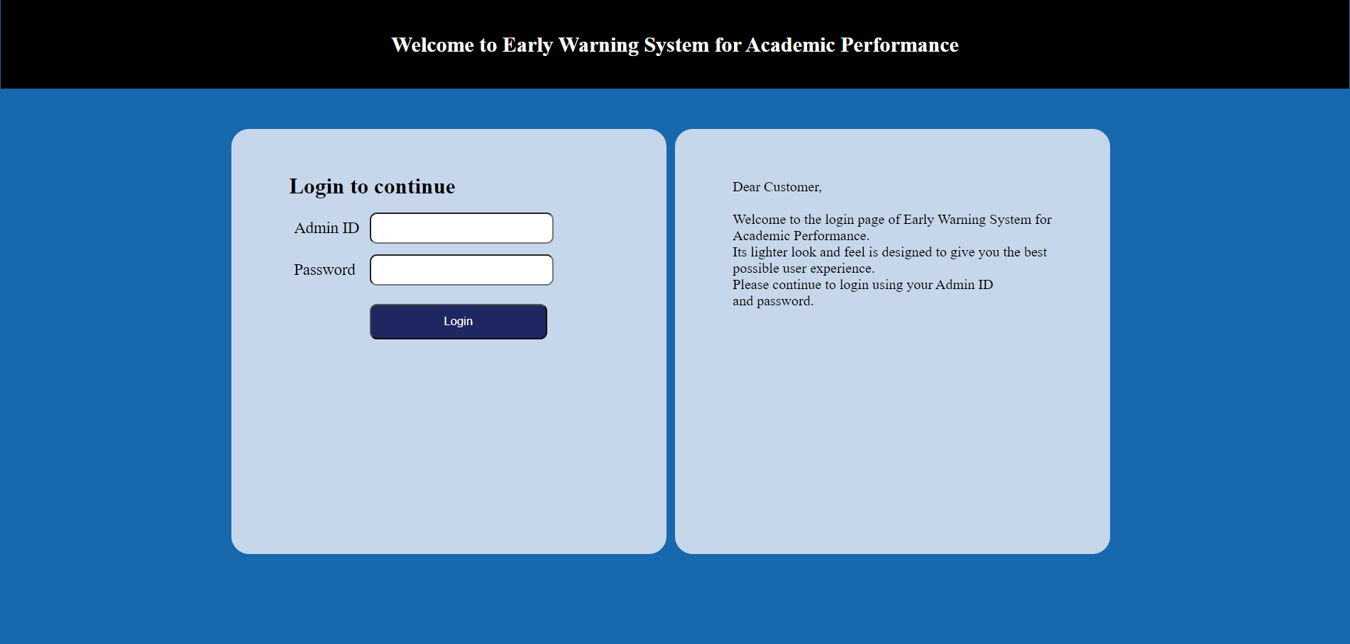
Experiment Results

Slide 15
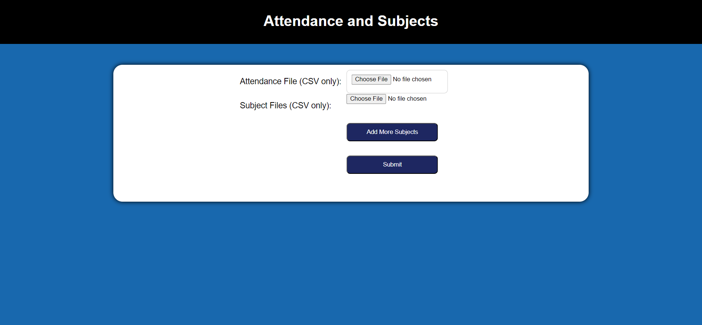
Experiment Results

Slide 16
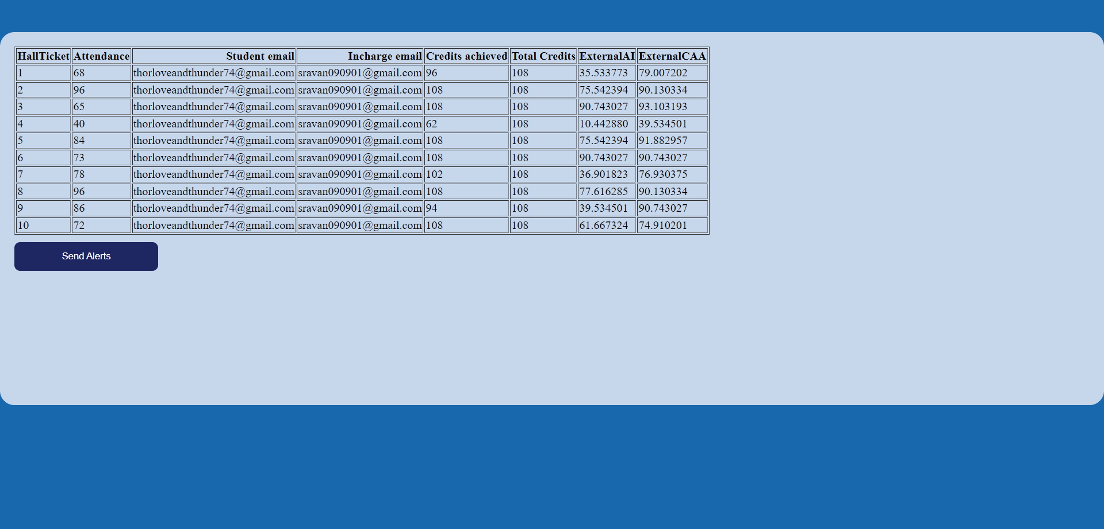
Experiment Results

Slide 17

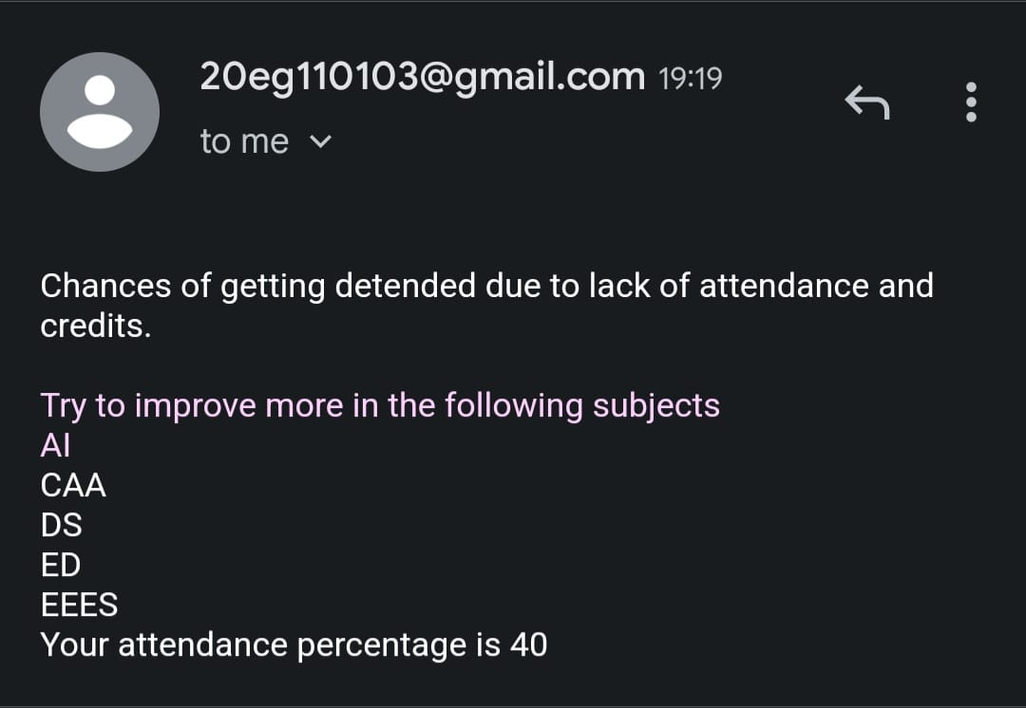
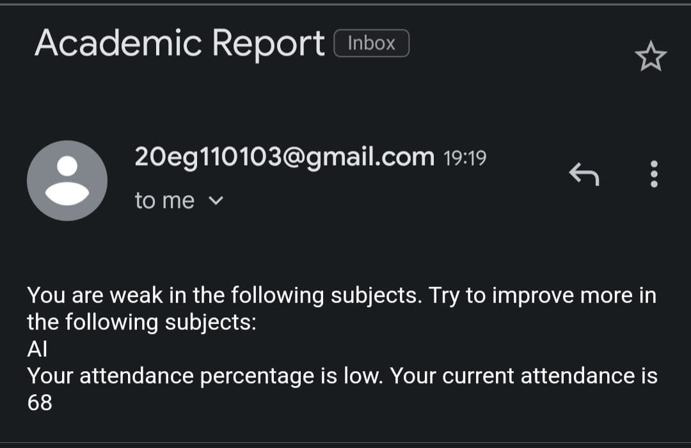
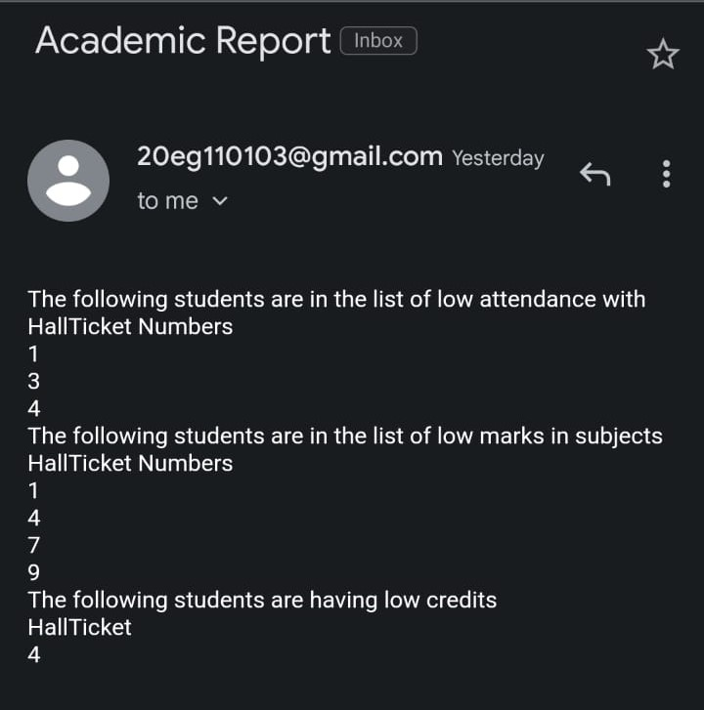
Experiment Results

Slide 18
Findings:
The findings of the experiments reveal the effectiveness of the Early Warning System in identifying at-risk students. It highlights the importance of attendance and credits in predicting student performance and provides insights into which machine learning models perform best in this context.

Slide 19
Parameters Improved by the Method:
Prediction Accuracy: The primary parameter improved by the Early Warning System is prediction accuracy. By leveraging machine learning models and incorporating features such as internal exam scores, attendance, and credits, the system aims to make more accurate predictions of students' external exam scores. This improvement in accuracy allows educators and administrators to identify students who may be at risk of underperforming more effectively.
Mathematical Formulas for Calculating Parameter Values:
Mean Squared Error (MSE): Formula: MSE = Σ(y_actual - y_predicted)^2 / n
Mean Absolute Error (MAE): Formula: MAE = Σ|y_actual - y_predicted| / n
R-squared (R2) Score: Formula: R2 = 1 - (Σ(y_actual - y_predicted)^2 / Σ(y_actual - y_mean)^2)
Root Mean Squared Error (RMSE): Formula: RMSE = √(Σ(y_actual - y_predicted)^2 / n)

Slide 20
Why our Parameter Values Improved:
Incorporation of Relevant Features
Machine Learning Models
Cross-Validation
Data Preprocessing
Feedback

Slide 21
Conclusion:
The system justifies its approach by demonstrating how predictive models can leverage internal exam scores, attendance, and credits to accurately predict students' external exam scores. It also justifies the choice of machine learning models and provides mathematical formulas for the evaluation metrics used to assess model performance.
In summary, the Early Warning System for Academic Performance is a data-driven solution designed to enhance student success and retention by identifying and supporting at-risk students early in their academic journey. It combines data collection, preprocessing, machine learning, and alerting mechanisms to provide a comprehensive and effective solution for educational institutions.

Slide 22
THANK YOU

